Slide 1
Sisters School District
2023 INTEGRATDE application
Aligning Six ODE Initiatives and SSD Strategic Plan
Helping our School District’s Mission:
A community connected education that
creates belonging, prepares and inspires

Slide 2

Purpose for Presentation
To share general priorities that are surfacing from the range of inputs
Review the process
Plan Overview
To hear additional feedback

Slide 3

Background
Integration effort was responsive to requests from educational leaders and state legislators
Combined processes for community engagement, needs assessment, planning, budgeting and evaluation for 6 programs
Designed to reduce burden and redundancies and improve the framework by which progress can be measured over time

Slide 4
Six ODE Initiatives
Creating One Integrated Cohesive Plan
High School Success (HSS) - Systems to improve graduation rates and college/career readiness.
Student Investment Account (SIA) - To meet students’ mental health, behavioral needs and increase academic achievement/reduce disparities for student focal groups.
Continuous Improvement Planning (CIP) - A process involving educator collaboration, data analysis, professional learning and reflection - toward improved outcomes for students and especially students experiencing disparity.
Career and Technical Education - Perkins V (CTE) - Improving access and participation in education and training programs that prepare learners for high-wage, high-skill, in-demand careers.
Early Indicator and Intervention System (EIIS) - The development of a data collection and analysis system, in which educators collaborate, to identify supports for students.
Every Day Matters - (EDM) - Embedded across the five other programs, focusing attention on student engagement, school culture, climate/safety & culturally sustaining pedagogy.

Slide 5
Sisters School District
Similar Goals
Oregon Department
of Education
Belong: Every student is known and connect to adults, peers and resources to develop emotional self-regulation and a foundation of resilience
Prepare: Every student is on a purposeful path to graduation and is taking an active role in their academic achievement, goal setting and character development
Inspire: every student is empowered to discover their passions and strengths through exceptional programs, community partnerships and inclusive practices
Well Rounded Education: a commitment to pedagogy and practices that ensure students are known and seen in their learning experiences.
Equity Advanced: creating a richer and more meaningful learning environment
Engaged Community: Deepening relationships and partnerships to build healthy school and district systems
Strengthen Systems and Capacity: Improvement that centers around relationships, grow community assets, collection and use data and hiring and retention

Slide 6
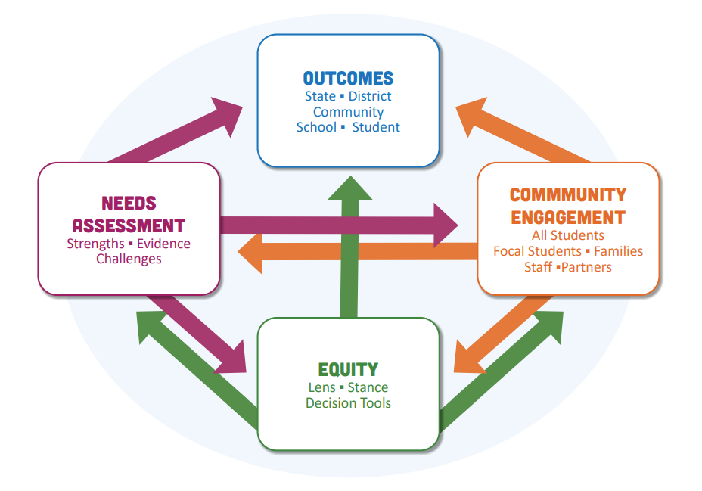
The Planning Process
Use lens to ensure ALL students are included
Community engagement
Needs Assessment
Review and use regional CTE Consortia inputs
Further Examination of Potential Impact on Focal Students tied to Planning Decisions
Development of a four-year plan with clear Outcomes, Strategies, and Activities

Slide 7
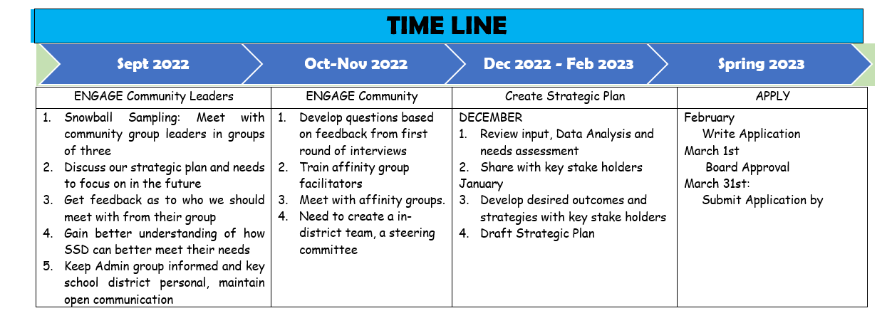

Slide 8
1st Round
Met with Community Leaders
Students Navigating Poverty and homelessness and Foster Care
Students with Disabilities
Community Partners
Emerging Bilingual Students and Students recently arrived
LGBTQ2sia+ Students
Athletics
Academically strong
Parent Groups
Students of Color

Slide 9
First Round Community Engagement Highlights
belonging.
Attendance
Resilience
Welcoming Environment
Respect each other
PREPARE
Continue focus on Reading, Writing & math
All areas read, write and analyze
Options to help those who learn differently
Inspire
Options for Students to inspire future

Slide 10

2nd Round: Listening Sessions
Focused Group / Affinity Group
Created questions from information gained from 1st round and desired information from the administrative team
Met with Facilitators
Creating a safe place to gain honest and helpful feedback
Facilitators met with small groups

Slide 11
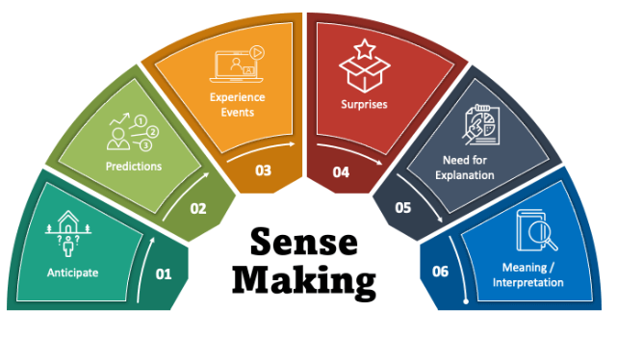
Affinity Group Sense Making Session
January 9th, 2023
Facilitated by HDESD
Admin and Facilitators
Find themes

Slide 12
Second Round Highlights
belonging
Language Barriers
Lack of understanding of various cultures
Want adults to pay attention to them
Most feel welcome and safe
PREPARE
Like hands on activities
Some classes help with connection to real world
Struggle with learning that is primarily content based
Proud of options
Not sure of how applicable classes are to real world
Inspire
Like M.S. study hall
Like hands on learning
Proud of staff
Variety of opportunities spark interest

Slide 13
Third Round: Administrative Survey
December 2, 2022
Belonging
more with attendance and lagging skills
Keep focus on relationships
Build more interdisciplinary programs
Improve student resilience
All student get involved
PREPARE
Place based education as much as possible
Focus on habits and skills
All students should have ECOS and IEE type of experience
Keep funding focused
Develop enrichment courses
Inspire
6 Year plan
Goals
Additional opportunities

Slide 14
Third Round: Survey Staff
January 20, 2023
Inspire
What went well?
Suggestions
Student groups, programs or area to focus on
Belonging
What went well
What contributed to this
Suggestions
PREPARE
What were contributing factors to the results (Graduation Rate, Reading and Writing Scores, 9th Grade on Track)
Next steps for us to prepare students for life after graduation

Slide 15
These Priorities are emerging
belonging
Attendance
Resilience
Welcoming Environment
Respect each other
Keep focus on relationships
Get students involved
PREPARE
Continue focus on Reading, Writing & math
Options to help those who learn differently
Give focus to habits and skills
Experiential Learning
Inspire
Options for Students to inspire future
Improve goal setting and four-six year plan

Slide 16
Our Intended Outcomes
Every student is known and connected to adults, peers and resources to develop emotional self-regulation and foundation of resilience.
Every student is on purposeful path to graduation and is taking an active role in their academic achievement, goal setting and character development
Every student is empowered to discover their passions and strengths through exceptional programs, community partnerships and inclusive practices.

Slide 17
Highlights to Our Action Steps
Maintain low student-to-teacher ratio
Grow relationships and student belonging
Strive to improve attendance and student involvement
Continue to grow student learning in Reading and Math
Improve ninth grade-on-track and graduation
Enhance programing and experiential learning
Improve student goal setting and organization

Slide 18
Key Investments

Slide 19
Longitudinal Performance Growth Targets (LPGTs)
ODE shall collaborate with the grant recipient to develop applicable Longitudinal Performance Growth Targets, based on:
  Data available for longitudinal analysis;
  Guidance established by the department; and
  Use the following applicable metrics for the overall population and disaggregated:
    Third-grade reading proficiency rates measured by ELA
    Ninth-grade on-track rates
    Regular attendance rates
    Four-year or on-time graduation rates
    Five-year completion rates
    Other local metrics may be used to develop applicable performance
Notes:
Applicants at or under 80 ADMr can delete this slide
For the Student Investment Account, growth targets are required in the areas shown.
We have been asked to develop draft LPGTs to submit with our Integrated Application due this March. Once ODE reviews and approves our plan, they will partner with us, as required by SIA legislation to further co-develop and finalize these growth targets. Our finalized growth targets will then need to be reviewed and approved by the board within the context of our grant agreement.
[You may add slides to show the draft targets or a hand-out if you wish to present them as drafts now, reminding participants that the final targets will need to be reviewed by the school board in the grant agreement coming later this spring or summer. ]

